Slide 1
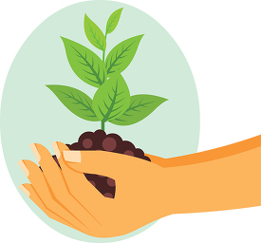

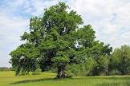
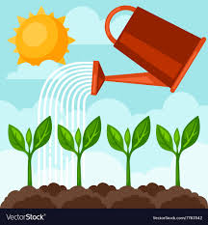
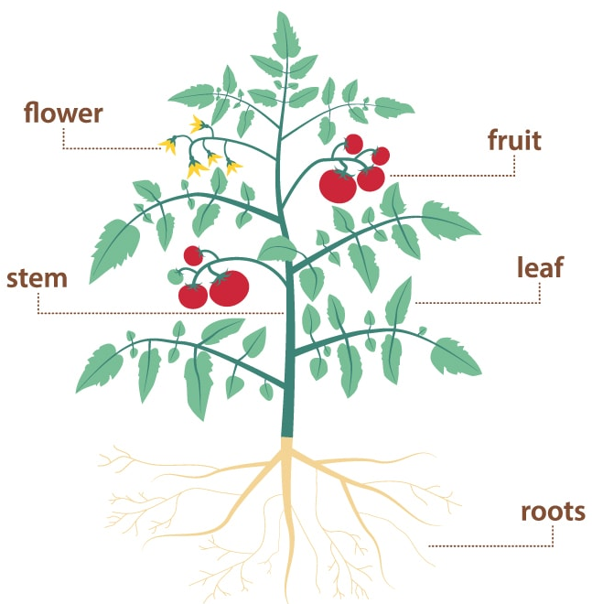
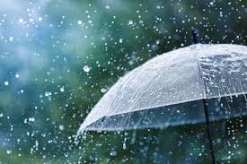
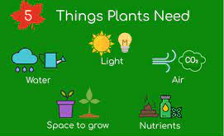
Pumas, Shooting Stars & The Pod
Science - Grow your own way!
Wren’s Nest
Primary School
What do plants need to grow?
Parts of a plant
All plants need space to grow, the right temperature, light, water, air, nutrients and time.

Slide 2

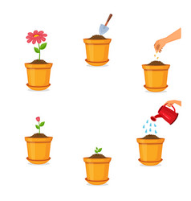
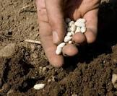
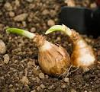
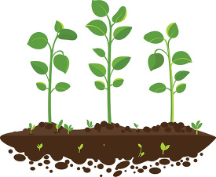
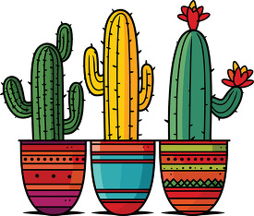
Key Vocabulary
Roots | Roots take in water and nutrients from the soil.
Stem | The stem holds the plant up and carries the water and nutrients from the roots to the leaves and flowers.
Leaves | Leaves catch sunlight to make energy.
Flowers | Flowers attract insects and birds.
Petals | Petals are the colourful part of the flower.
Fruit | Fruit contains the plant’s seeds. Sometimes humans try to grow fruit without seeds because it’s easier to eat.
Seeds | Seeds grow into new plants.
Bulbs | Bulbs grow into new plants..
Wren’s Nest
Primary School
What are the best conditions for plants to grow?

